Slide 1
Introduction to Computer Simulation of Physical Systems
(Lecture 4)
PHYS 3061

Slide 2
Decay processes
The power of mathematics when applied to physics:
  seemingly unrelated problems
    frequently have the same mathematical formulation.
    Any examples?
if we can solve one problem,
  solve other problems that might appear to be unrelated.

Slide 3
Equivalent differential equations:
  the growth of bacteria,
  the cooling of a cup of hot water,
  the charging of a capacitor in a RC circuit,
  nuclear decay

Slide 4
Consider a large number of radioactive nuclei.
Although the number of nuclei is discrete,
  this number can be treated as a continuous variable
  because the number of nuclei is very large.
The law of radioactive decay
  the rate of decay is proportional to the number of nuclei.
Thus we can write
dN/dt= -λN,

Slide 5
dN/dt= -λN,
  where N is the number of nuclei and λ is the decay constant.
Of course, we do not need to use a computer to solve this decay equation,
  the analytical solution is N(t) = N₀e⁻ ^{λ t},
  where N₀ is the initial number of particles.
  The quantity λ has dimensions of inverse time.

Slide 6
Cooling of a cup of coffee
The nature of the energy transfer from the hot water in a cup of coffee to the surrounding air is complicated and in general involves the mechanisms of convection, radiation, evaporation, and conduction.

Slide 7
Suppose, the temperature difference between the water and its surroundings is not too large,
  the rate of change of the temperature of the water may be assumed to be proportional to the temperature difference.
We can formulate it as :
dT/dt= -r (T - T_{s})

Slide 8
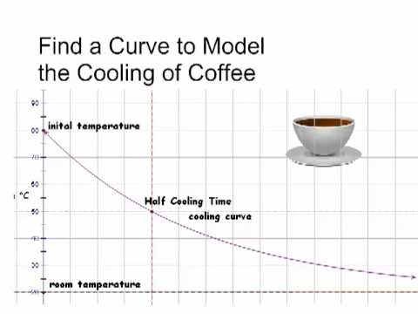
dT/dt= -r (T - T_{s})
  where T is the temperature of the water,
  T_{s} is the temperature of its surroundings, and r is the cooling constant.
  The minus sign implies that if T > T_{s}, the temperature of the water will decrease with time.
The value of the cooling constant r depends on the heat transfer mechanism,
  the contact area with the surroundings, and the thermal properties of the water.
The relation is sometimes known as Newton’s law of cooling, even though the relation is only approximate,
  and Newton did not express the rate of cooling in this form.

Slide 9
Numerical Integration of Newton’s Equation of Motion
several of the common finite difference methods for the solution of Newton’s equations of motion with continuous force functions.
The number and variety of algorithms currently in use is evidence that
  no single method is superior under all conditions.

Slide 10
Newton’s equations of motion in the form
dv/dt= a(t),
dx/dt= v(t)
The goal of finite difference methods is to determine the values of x_{n+1} and v_{n+1} at time t_{n+1} = t_{n} + Δt.
We already have seen that Δt must be chosen so that the integration method generates a stable solution.
If the system is conservative, Δt must be sufficiently small
  so that the total energy is conserved to the desired accuracy.

Slide 11
The nature of many of the integration algorithms can be understood by expanding
v_{n+1} = v(t_{n} + Δt) and x_{n+1} = x(t_{n} + Δt) in a Taylor series.
We write v_{n+1} = v_{n} + a_{n}Δt + O((Δt)²)
x_{n+1} = x_{n} + v_{n}Δt +1/2a_{n}(Δt)² + O((Δt)³)
The familiar Euler algorithm is equivalent to retaining the O(Δt) terms :
v_{n+1} = v_{n} + a_{n}Δt
x_{n+1} = x_{n} + v_{n}Δt. (Euler algorithm)

Slide 12
Because order Δt terms are retained, the local truncation error, the error in one time step, is order (Δt)².
The global error, the total error over the time of interest, due to the accumulation of errors from step to step is order Δt.

Slide 13
This estimate of the global error
  the number of steps into which the total time is divided is proportional to 1/Δt.
  Hence, the order of the global error is reduced by a factor of 1/Δt relative to the local error.
We say that an algorithm is nth order if its global error is order (Δt)^{n}.
The Euler algorithm is an example of a first-order algorithm.

Slide 14
The Euler algorithm is asymmetrical because it advances the solution by a time step Δt,
  But uses information about the derivative only at the beginning of the interval.
  We already have found that the accuracy of the Euler algorithm is limited and that frequently its solutions are not stable.
A simple modification yields solutions that are stable for oscillatory systems.
  Euler-Cromer
    Use v_{n+1}
  Midpoint algorithm
    use the mean velocity, ½ (v_{n}+v_{n+1})
    Second order accuracy!

Slide 15
Although the midpoint approximation yields exact results for constant acceleration, it usually does not yield much better results than the Euler algorithm.
In fact, both algorithms are equally poor, because the errors increase with each time step.

Slide 16
A higher order algorithm whose error is bounded is the half-step algorithm.
In this algorithm the average velocity during an interval is taken to be the velocity in the middle of the interval.
The half-step algorithm can be written as v_{n+1/2}= v_{n−1/2}+ a_{n}Δt,
x_{n+1} = x_{n} + v_{n+1/2}Δt. (half-step algorithm)

Slide 17
Note that the half-step algorithm is not self-starting,
  does not allow us to calculate v_{1/2}.
This problem can be overcome by adopting the Euler algorithm for the first half step:
V_{1/2}= v₀ +1/2a₀ Δt.
Because the half-step algorithm is stable, it is a common textbook algorithm!

Slide 18
The Euler-Richardson algorithm
x₁ ≈x(t + Δt) = x(t) + v(t)Δt +1/2a(t)(Δt)².
The notation x₁ implies that x(t+Δt) is related to x(t) by one time step.
We also may divide the step Δt into half steps and write the first half step, x(t + 1/2Δt), as
x(t +1/2Δt) ≈ x(t) + 1/2v(t)Δt+1/2a(t)(1/2Δt)²

Slide 19
The second half step, x₂(t + Δt), may be written as
x₂(t + Δt) ≈ x(t +1/2Δt) + 1/2v(t +1/2Δt)Δt+1/2a(t +1/2Δt)(Δt/2)².

Slide 20
x₂(t + Δt) ≈x(t) +1/2[v(t) + v(t +1/2Δt)]Δt +1/2[a(t) + a(t +1/2 Δt)](1/2 Δt)²
Now a(t + 1/2Δt) ≈a(t) + 1/2a′(t)Δt.
Hence to order (Δt)², it becomes
x₂(t + Δt) ≈x(t) +1/2[v(t) + v(t +1/2Δt)]Δt +1/2[2a(t)](1/2 Δt)²

Slide 21
We can find an approximation that is accurate to order (Δt)³ by combining x1 and x2 so that the terms to order (Δt)² cancel.
The combination that works is 2x₂ - x₁, which gives the
Euler-Richardson result:
x_{er}(t + Δt) ≡2x₂(t+Δt)-x₁ (t+Δt)=x(t)+v(t+1/2Δt)]Δt +O (Δt)³
v_{er} ≡2v₂(t+Δt)-v₁ (t+Δt)=v(t)+a(t+1/2Δt)]Δt +O (Δt)³

Slide 22
A bonus of the Euler-Richardson algorithm is that the quantities |x₂ - x₁| and |v₂ - v₁| give an estimate for the error.
We can use these estimates to change the time step so that the error is always within some desired level of precision.

Slide 23
One of the most common drift-free higher order algorithms is commonly attributed to Verlet.
We write the Taylor series expansion for x_{n−1}
x_{n−1} = x_{n}- v_{n}Δt +1/2a_{n}(Δt)².

Slide 24
If we add the forward and reverse forms respectively, we obtain
x_{n+1} + x_{n−1} = 2x_{n} + a_{n}(Δt)² + O((Δt)⁴)
  Why can we do this?
or
x_{n+1} = 2x_{n}- x_{n−1} + a_{n}(Δt)². (leapfrog algorithm)
the subtraction of the Taylor series for x_{n+1} and x_{n−1} yields v_{n} = (x_{n+1} - x_{n−1})/2Δt (leapfrog algorithm)

Slide 25
Note that the global error associated with the leapfrog algorithm is third-order for the position and second-order for the velocity.
However, the velocity plays no part in the integration of the equations of motion.
The leapfrog algorithm is also known as the explicit central difference algorithm.
Because this form of the leapfrog algorithm is not self-starting, another algorithm must be used to obtain the first few terms.

Slide 26
An additional problem is that the new velocity is found by computing the difference between two quantities of the same order of magnitude.
  Really no good!
Such an operation results in a loss of numerical precision and may give rise to roundoff errors.

Slide 27
A mathematically equivalent version of the leapfrog algorithm is given by
x_{n+1} = x_{n} + v_{n}Δt +1/2a_{n}(Δt)²
v_{n+1} = v_{n} +1/2 (a_{n+1} + a_{n})Δt. (velocity Verlet algorithm)
the velocity form of the Verlet algorithm, is self-starting and minimizes roundoff errors.

Slide 28
Another useful algorithm that avoids the roundoff errors of the leapfrog algorithm is due to Beeman and Schofield.
We write the Beeman algorithm in the form:
x_{n+1} = x_{n} + v_{n}Δt +1/6(4a_{n} - a_{n−1})(Δt)²
v_{n+1} = v_{n} +1/6(2a_{n+1} + 5a_{n} - a_{n−1})Δt. (Beeman algorithm)

Slide 29
The most common finite difference method for solving ordinary differential equations is the Runge-Kutta method.
Because Runge-Kutta algorithms are self-starting, they are frequently used to obtain the first few iterations for an algorithm that is not self-starting.
For details, read the textbook because it has been covered in PHYS2061.

Slide 30
The Dynamics of Many Particle
Systems
We simulate the dynamical behavior of many particle systems such as dense gases, liquids, and solids and observe their qualitative features. In addition to condense matter simulations, molecular dynamics type of simulations are widely adopted in astrophysics as well.
Some of the basic ideas of equilibrium statistical mechanics and kinetic theory are introduced.

Slide 31
Introduction
With the knowledge of the laws of physics at the microscopic level,
  how to understand the behavior of gases, liquids, and solids and more complex systems?
  such as polymers and proteins?
For example, consider two cups of water prepared under similar conditions.
Each cup contains approximately 1025 molecules which mutually interact and,
to a good approximation, move according to the laws of classical physics.

Slide 32
Although the intermolecular forces produce a complicated trajectory for each molecule, the observable properties of the water in each cup are indistinguishable and are easy to describe.
For example, the temperature of the water in each cup is independent of time even though the positions and velocities of the individual molecules are changing continually.

Slide 33
Although the intermolecular forces produce a complicated trajectory for each molecule,
  the observable properties of the water in each cup are indistinguishable and are easy to describe.
  For example, the temperature of the water in each cup is independent of time
    even though the positions and velocities of the individual molecules are changing continually.

Slide 34
One way to understand the behavior of a classical many particle system is to simulate the trajectory of each particle.
This approach, known as molecular dynamics, has been applied to various systems
  has given us much insight into a variety of systems in which the particles obey the laws of classical dynamics.

Slide 35
A calculation of the trajectories of many particles would not be very useful unless we know the right questions to ask.
Saving these trajectories would quickly fill up any storage medium, and we do not usually care about the trajectory of any particular particle.
  If God is a programmer, does he save all the history?
What are the useful quantities needed to describe these many particle systems?
What are the essential characteristics and regularities they exhibit?

Slide 36
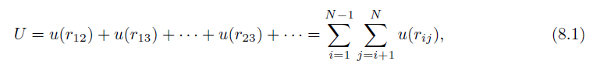
The Intermolecular Potential
We assume that the dynamics can be treated classically,
  the molecules are spherical
  and chemically inert
  and their internal structure can be ignored,
  and the interaction between any pair of particles depends only on the distance between them.
In this case the total potential energy U is a sum of two-particle interactions:

Slide 37
where u(r_{ij}) depends only on the magnitude of the distance r_{ij} between particles i and j.
The pairwise interaction form is appropriate for simple liquids such as liquid argon.
The form of u(r) for electrically neutral molecules can be constructed by a first principles quantum mechanical calculation.
Such a calculation is very difficult, and it usually is sufficient to choose a simple phenomenological form for u(r).
The most important features of u(r) are a strong repulsion for small r and a weak attraction at large r.

Slide 38
The repulsion for small r is a consequence of the Pauli exclusion principle.
  That is, the electron wave functions of two molecules must distort to avoid overlap, causing some of the electrons to be in different quantum states.
  What about other particles? Are there particles that can occupy the same state?
The net effect is an increase in kinetic energy and an effective repulsive interaction between the electrons,
  Known as core repulsion.
The dominant weak attraction at larger r is due to the mutual polarization of each molecule; the resultant attractive potential is called the van der Waals potential.

Slide 39
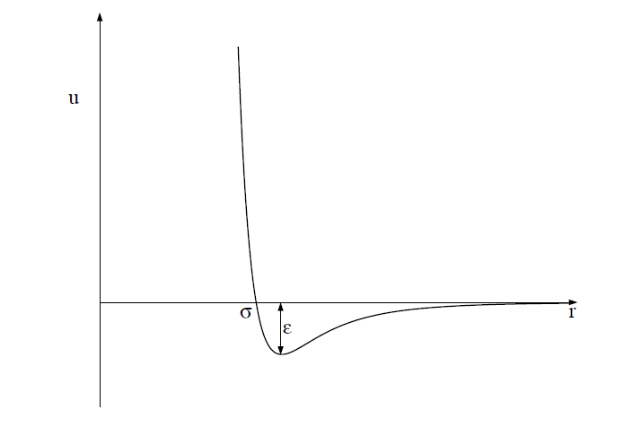
One of the most common phenomenological forms of u(r) is the Lennard-Jones potential:
u(r) = 4ϵ[(σ/r)¹²−(σ/r)⁶].

Slide 40
The r ⁻¹² form of the repulsive part of the interaction was chosen for convenience only and has no fundamental significance.
The attractive 1/r⁶ behavior at large r corresponds to the van der Waals interaction.
The Lennard-Jones potential is parameterized by a length σ and an energy ϵ.
Note that u(r) = 0 at r = σ, and that u(r) is close to zero for r > 2.5σ.
The parameter ϵ is the depth of the potential at the minimum of u(r); the minimum occurs at a separation r = 2^{1/6} σ.

Slide 41
Units
convenient to choose units
  the computed quantities are neither too small nor too large.
    What’s the problem of being too small or too large?
  Because the values of the distance and the energy associated with typical liquids are very small in SI units,
    What’s the typical value for distance and energy?
  we can choose the Lennard-Jones parameters σ and ϵ as the units of distance and energy, respectively.
  We can also choose the unit of mass to be the mass of one atom, m. We can express all other quantities in terms of σ, ϵ, and m.

Slide 42
For example, we can measure velocities in units of (ϵ/m)^{1/2},
and the time in units of σ(m/ϵ)^{1/2}.
The values of σ, ϵ, and m for argon are given in the next page.
If we use these values, we find that the unit of time is 2.17×10⁻¹² s.
The units of some of the other physical quantities of interest also are shown in next page.

Slide 43
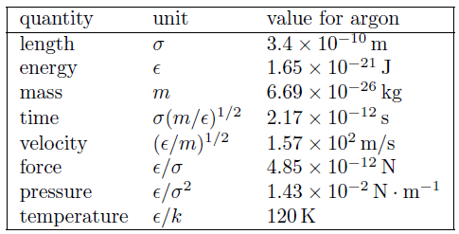
The system of units used in the molecular dynamics simulations of particles interacting via the Lennard-Jones potential. The numerical values of σ, ϵ, and m are for argon. The quantity k is Boltzmann’s constant and has the value k = 1.38 × 10⁻²³ J/K. The unit of pressure is for a two-dimensional system.

Slide 44
All program variables are in reduced units,
  for example, the time in our molecular dynamics program is expressed in units of σ(m/ϵ)^{1/2}.
  Suppose that we run our molecular dynamics program for 2000 time steps with a time step Δt = 0.01.
  The total time of our run is 2000 × 0.01 = 20 in reduced units or 4.34 × 10⁻¹¹ s for argon.

Slide 45
  The duration of a typical molecular dynamics simulation is in the range of 10–10⁴ in reduced units, corresponding to a duration of approximately 10⁻¹¹–10⁻⁸ s. The longest practical runs are the order of 10⁻⁶ s.

Slide 46
The Numerical Algorithm
we need to introduce a numerical method for computing the trajectory of each particle.
The criteria for a good numerical integration method include that
  it conserves the phase-space volume and be consistent with the known conservation laws, is time reversible, and is accurate for relatively large time steps to reduce the CPU time needed for the total time of the simulation.

Slide 47
We should use an algorithm for the relatively long time of interest in molecular dynamics simulations!
We adopt the commonly used second-order algorithm:
x_{n+1} = x_{n} + v_{n}Δt +1/2a_{n}(Δt)²
v_{n+1} = v_{n} +1/2(a_{n+1} + a_{n})Δt.

Slide 48
The new position is used to find the new acceleration a_{n+1},
  used together with a_{n} to obtain the new velocity v_{n+1}.
  The algorithm is known as the Verlet (or sometimes the velocity Verlet) algorithm.
  The sample code will use Verlet implementation of the ODESolver interface to implement the algorithm.
  Thus, the x, v_{x}, y, and v_{y} values for the ith particle will be stored in the state array at state[4*i], state[4*i+1], state[4*i+2], and state[4*i+3], respectively.

Slide 49
Periodic Boundary Conditions
A useful simulation must incorporate as many of the relevant features of the physical system of interest as possible.
Usually we want to simulate a gas, liquid, or a solid in the bulk, that is, systems of at least N ∼ 10²³ particles.
  What’s the approximate number of particles on the surface? A rough estimation.
In such systems the fraction of particles near the walls of the container is negligibly small.

Slide 50
The number of particles that can be studied in a molecular dynamics simulation is typically 10³–10⁵,
  although we can simulate the order of 10⁹ particles using clusters of computers.
  If you are interested, try to learn parallel computing with our department cluster!
For these relatively small systems, the fraction of particles near the walls of the container is significant, and hence the behavior of such a system would be dominated by surface effects.

Slide 51
The most common way of minimizing surface effects and to simulate more closely the properties of a bulk system is to use what are known as periodic boundary conditions,
  although the minimum image approximation would be a more accurate name.

Slide 52

This boundary condition is familiar to anyone who has played the Pacman computer game!
Consider N particles that are constrained to move on a line of length L.
The application of periodic boundary conditions is equivalent to considering the line to be a circle, and hence the maximum separation between any two particles is L/2.

Slide 53
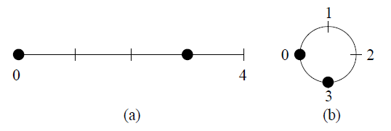
The generalization of periodic boundary conditions to two dimensions is equivalent to imagining a box with opposite edges joined so that the box becomes the surface of a torus (the shape of a doughnut or a bagel).
The three-dimensional version of periodic boundary conditions cannot be visualized easily, but the same methods can be used.
(a) Two particles at x = 0 and x = 3 on a line of length L = 4; the distance between the
particles is 3.
(b) The application of periodic boundary conditions for short range interactions is
equivalent to thinking of the line as forming a circle of circumference L.
In this case the minimum distance between the two particles is 1.

Slide 54
The implementation of periodic boundary conditions is straightforward.
If a particle leaves the box by crossing a boundary in a particular direction, we add or subtract the length L of the box in that direction to the position.
Translational symmetry vs. rotational symmetry.

Slide 55
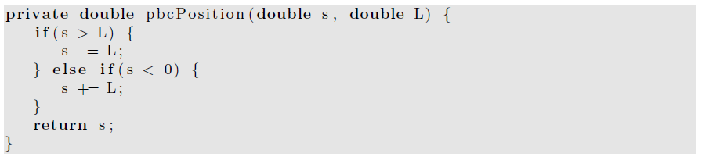
Calculation of the position of particle in the central cell.

Slide 56
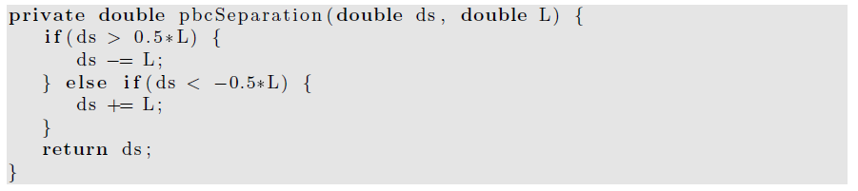
To compute the minimum distance ds in a particular direction between two particles, we can use the method pbcSeparation.

Slide 57
The nature of periodic boundary conditions.
Imagine a set of N particles in a two-dimensional box or cell.
The use of periodic boundary conditions implies that the central cell is duplicated an infinite number of times to fill the space.

Slide 58
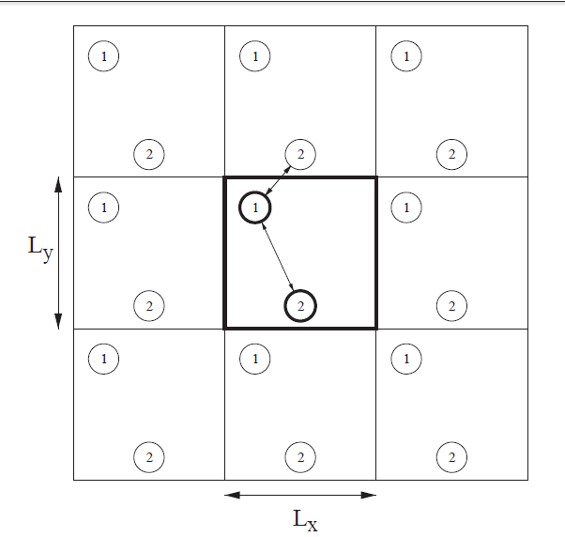
the first several image cells for N = 2.
The shape of the central cell must be such that the cell fills space under successive translations.
Each image cell contains the original particles in the same relative positions as the central cell.

Slide 59
Periodic boundary conditions yield an infinite system!
  although the positions of the particles in the image cells are identical to the positions of the particles in the central cell.
These boundary conditions also imply that every point in the cell is equivalent and that there is no surface.

Slide 60
As a particle moves in the original cell,
  its periodic images move in the image cells.
  Hence only the motion of the particles in the central cell needs to be followed.
When a particle enters or leaves the central cell,
  the move is accompanied by an image of that particle leaving or entering a neighboring cell through the opposite face.

Slide 61
The total force on a given particle i is due to the force from every other particle j within the central cell and from the periodic images of particle j.
That is, if particle i interacts with particle j in the central cell, then particle i interacts with all the periodic replicas of particle j.
  Big trouble, the total force may not even converge with system sizes.
  Any such examples with a long range interaction to show such kind of divergence feature?

Slide 62
There are an infinite number of contributions to the force on any given particle!
For long-range interactions such as the Coulomb potential, these contributions have to be included using special methods.

Slide 63
For short-range interactions, we can reduce the number of contributions by adopting the minimum image approximation,
which assumes that particle i in the central cell interacts only with the nearest image of particle j;
the interaction is set equal to zero if the distance of the image from particle i is greater than L/2.

Slide 64
A Molecular Dynamics Program
In this section, we demonstrate a molecular dynamics program to simulate a two-dimensional system of particles interacting via the Lennard-Jones potential.
We choose two rather than three dimensions because it is easier to visualize the results and the calculations are not as time consuming.
In the lab, you will be asked to write a code to simulate 3D with fixed boundaries.

Slide 65
In principle, we could define a class for a particle, and instantiate an object for each particle.
  However, this use would be very inefficient and would take up more memory and CPU time than using one class to represent all N particles.
  Instead we will store the x- and y-components of the positions and velocities in the state array and store the accelerations of the particles in a separate array.
  OOP is always more expensive!
We will develop two classes, LJParticles and LJParticlesApp.

Slide 66
Because the system is deterministic, the nature of the motion is determined by the initial conditions.
According to the equipartition theorem, the mean kinetic energy of a particle per degree of freedom is kT/2,
  where k is Boltzmann’s constant and T is the temperature.

Slide 67
We can generalize this relation to define the temperature at time t by
  k_{B}T(t) =2K(t)/ (d N) =1/(N d) * Σ [m_{i}v_{i}(t) · v_{i}(t)],
    where i is from 1 to N. K is the total kinetic energy of the system, v_{i} is the velocity of particle i with mass m_{i}, and d is the spatial dimension of the system.

Slide 68
The following method gives the particles a random set of velocities, sets the total velocity (momentum) to zero, and then rescales the velocities so that the desired initial kinetic energy is achieved.

Slide 69
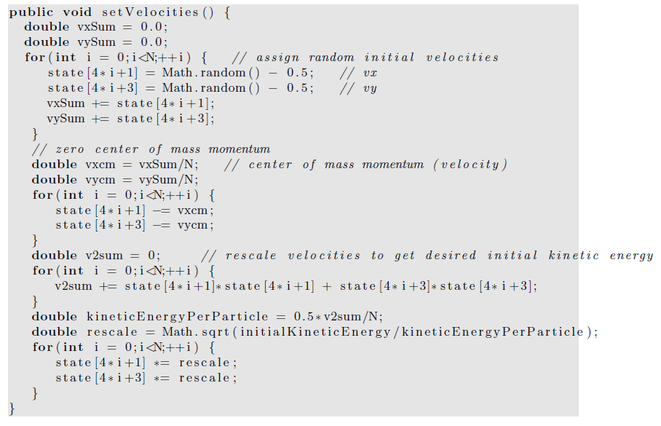

Slide 70
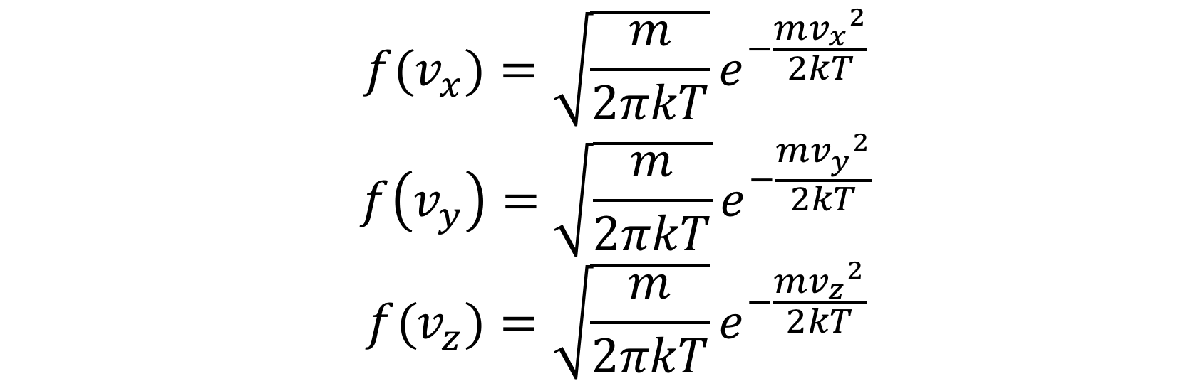

Initialization with Maxwell Boltzmann distribution
One problem of the textbook code,
  It give a uniform distribution of velocity.
The speed with Maxwell Boltzmann distribution,
Equivalently, the one-dimensional velocity satisfies Gaussian distribution,

Slide 71
Convert uniform distribution to other distributions
For Gaussian distribution, direct conversion (Box-Muller method) may be used,
For general distribution, Monte Carlo method should be used
(If you are interested in Monte Carlo method , some of the contents will be covered later this semester and more advanced materials will be covered in
PHYS4061 Computational Physics)

Slide 72
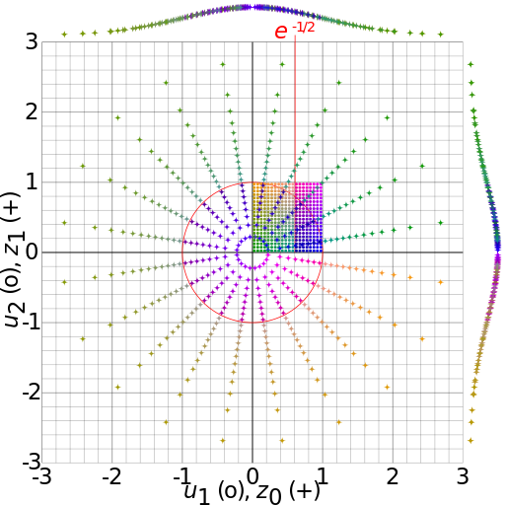

Convert uniform distribution to Gaussian distribution
Box-Muller transform,
Where
  ϑ1, ϑ2 are independent random numbers, 0 < ϑ1, ϑ2 < 1
  x1, x2 are independent random numbers with standard normal distribution
https://en.wikipedia.org/wiki/Box–Muller_transform#/media/File:Box-Muller_transform_visualisation.svg

Slide 73
Maxwell Boltzmann distribution
After getting the one-dimensional velocity, which satisfies
Simply, get the velocity by

Slide 74
We will find that setting the initial velocities so that the initial temperature is the desired value
  does not guarantee that the system will maintain this temperature when it reaches equilibrium.
    Why?
Determining an initial configuration that satisfies the desired conditions is an iterative process.

Slide 75
If the system is a dilute gas, we can choose the initial positions of the particles by placing them at random,
  making sure that no two particles are too close to one another.
If two particles were too close, they would exert a very large repulsive force F on one another
  any simple finite difference integration method would break down because the condition (F/m)(Δt)² ≪ σ would not be satisfied.
  (In dimensionless units, this condition is F(Δt)² ≪ 1.)

Slide 76
If we assume that the separation between two particles is greater than 2^{1/6}σ,
  this condition is satisfied.
The following method places particles at random such that no two particles are closer than 2^{1/6}σ.
Note that we use a do/while statement to insure that the body of the loop is executed at least once!

Slide 77
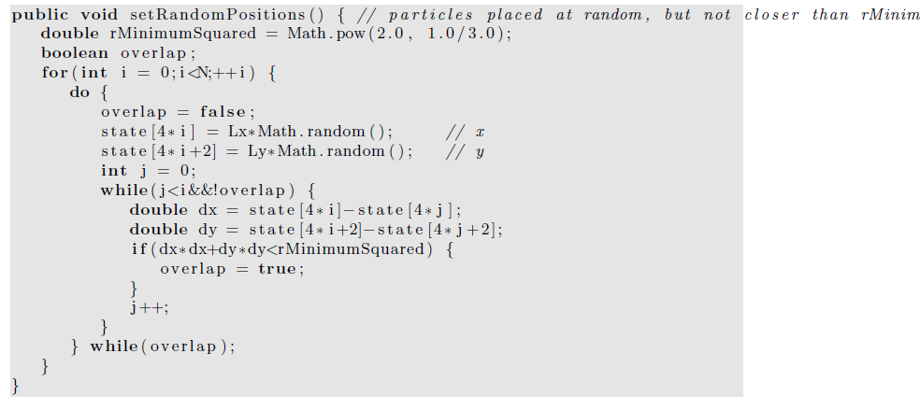

Slide 78
Any problems with this algorithm?
Any solutions?

Slide 79
Finding a random configuration of particles in which no two particles are closer than 2^{1/6}σ becomes much too inefficient if the system is dense.
It is possible to choose the initial positions randomly without regard to their separations if we include a fictitious drag force proportional to the square of the velocity.

Slide 80
The effect of such a force is to dampen the velocity of those particles whose velocities become too large due to the large repulsive forces exerted on them.
We then would have to run for a while until all the velocities satisfy the condition vΔt ≪ 1.
As the velocities become smaller, we may gradually reduce the friction coefficient.

Slide 81
In general, the easiest way of obtaining an initial configuration with the desired density is to place the particles on a regular lattice.
If the temperature is high or if the system is dilute, the system will “melt” and become a liquid or a gas; otherwise, it will remain a solid.

Slide 82
If our goal is to equilibrate the system at fluid densities, it is not necessary to choose the correct equilibrium symmetry of the lattice.
The method setRectangularLattice places the particles on a rectangular lattice.
To make the method simple, the user must specify the number of particles per row, nx, and the number per column, ny.

Slide 83
The linear dimensions Lx and Ly are adjustable parameters and can be varied after initialization to be as close as possible to their desired values.
In this way we can vary the density by varying the volume (area) without setting up a new initial configuration.

Slide 84
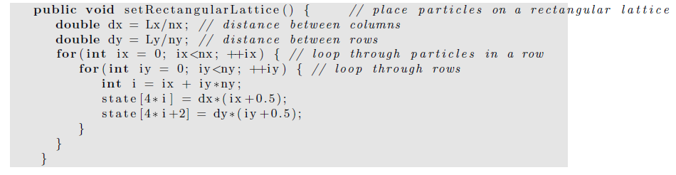

Slide 85
The most time consuming part of a molecular dynamics simulation is the computation of the accelerations of the particles.
The method computeAcceleration determines the total force on each particle due to the other N −1 particles and uses Newton’s third law to reduce the number of calculations by a factor of two.

Slide 86
For a system of N particles, there are a total of N(N −1)/2 possible interactions.
Because of the short range nature of the Lennard-Jones potential, we could truncate the force at r = rc and ignore the forces from particles whose separation is greater than rc.
However, for N < 400, it is easier to include all possible interactions, no matter how small.

Slide 87
The quantity virial accumulated in computeAcceleration will be discussed later,
  We will see that it is related to the pressure.
  It is convenient to also calculate the potential energy in computeAcceleration.
  Note that in reduced units, the mass of a particle is unity, and hence the acceleration and force are equivalent.

Slide 88
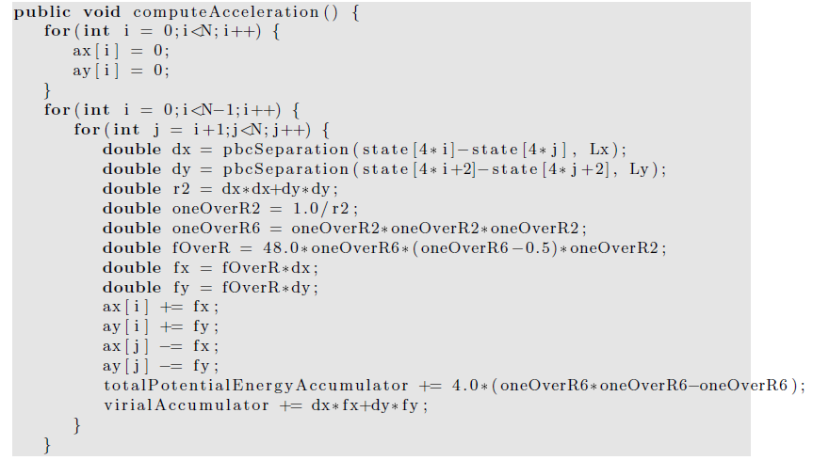
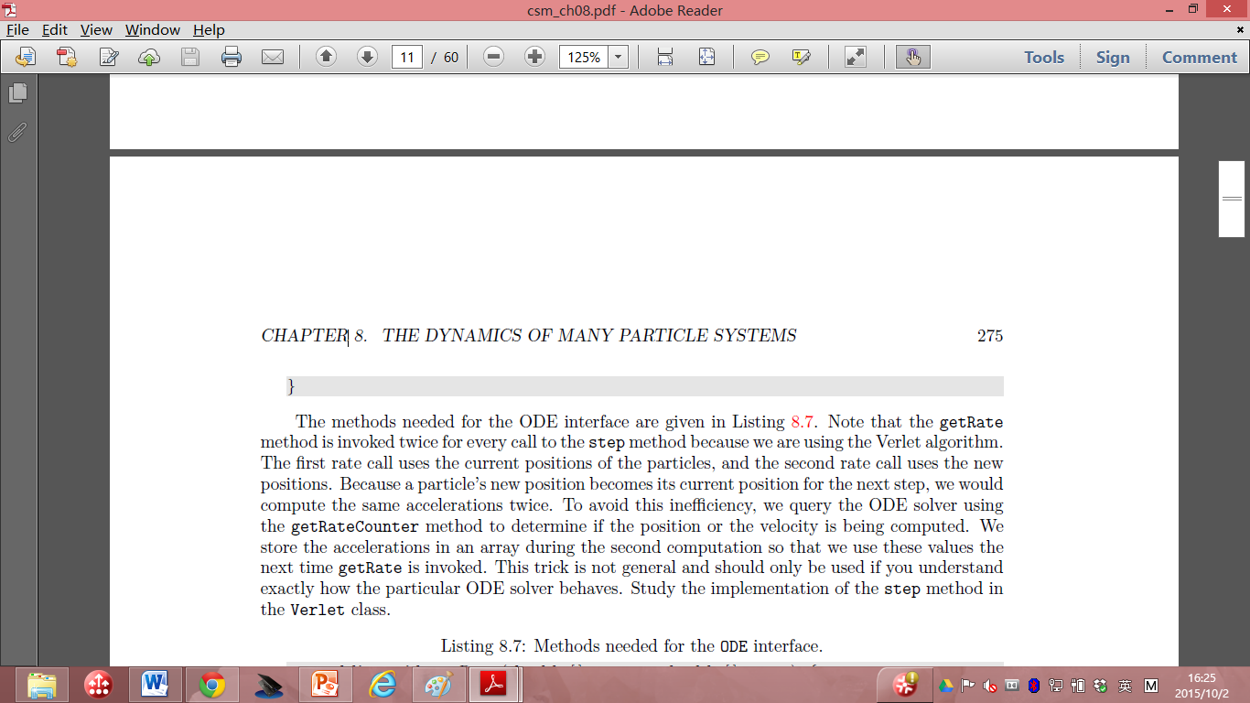

Slide 89
The methods needed for the ODE interface are given in next few pages.
Note that the getRate method is invoked twice for every call to the step method because we are using the Verlet algorithm.
The first rate call uses the current positions of the particles, and the second rate call uses the new positions.

Slide 90
Because a particle’s new position becomes its current position for the next step, we would compute the same accelerations twice.
To avoid this inefficiency, we query the ODE solver using the getRateCounter method to determine if the position or the velocity is being computed.

Slide 91
We store the accelerations in an array during the second computation so that we use these values the next time getRate is invoked.
This trick is not general and should only be used if you understand exactly how the particular ODE solver behaves.

Slide 92
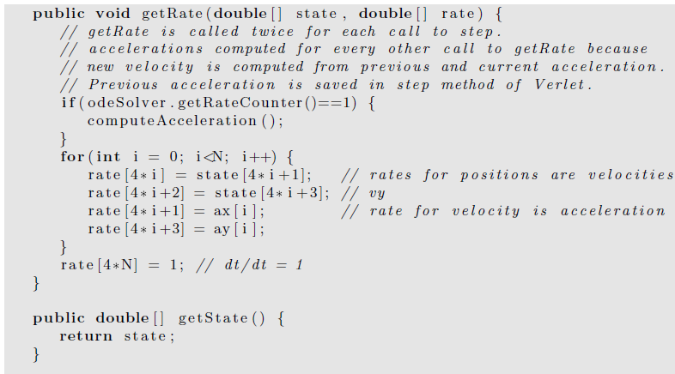

Slide 93
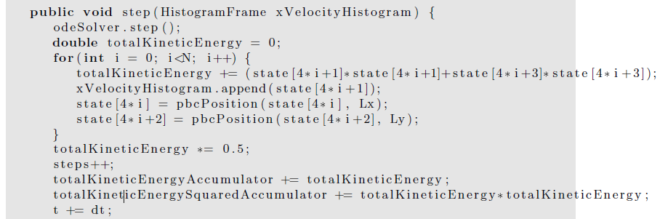
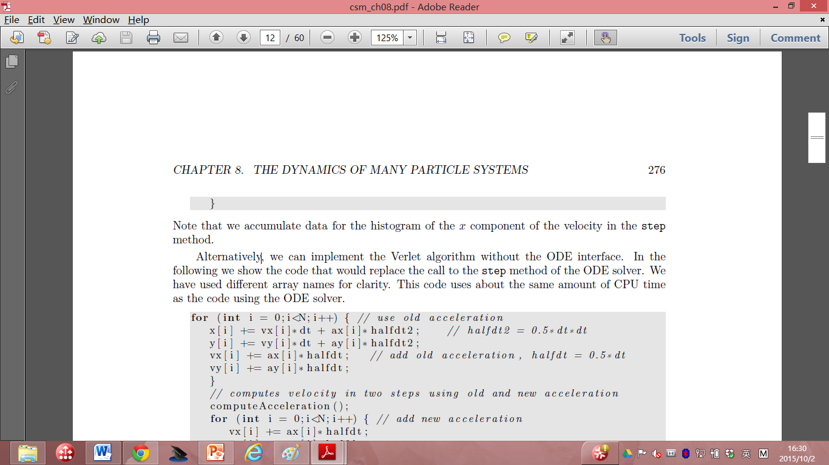

Slide 94
Note that we accumulate data for the histogram of the x component of the velocity in the step method.
Alternatively, we can implement the Verlet algorithm without the ODE interface.
In the following we show the code that would replace the call to the step method of the ODE solver.
We have used different array names for clarity.
This code uses about the same amount of CPU time as the code using the ODE solver.

Slide 95
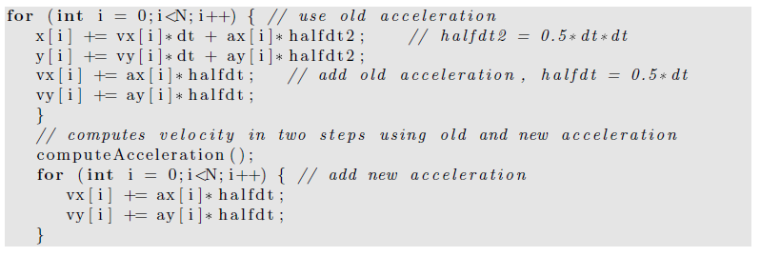
In next page, we give some of the methods for computing the temperature, pressure (details will be covered later), and the heat capacity (also covered later).
The mean total energy should remain constant, but we compute it to test how well the algorithm conserves the total energy.

Slide 96
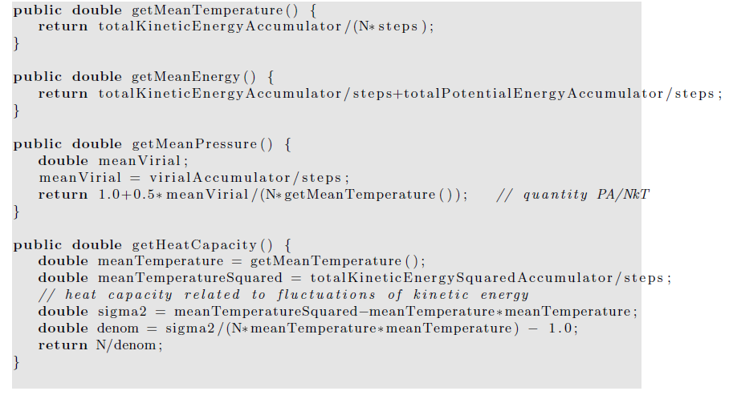

Slide 97
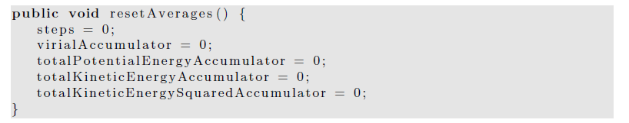
The resetAverages method is used to set the accumulated averages to zero so that the initial transient behavior can be removed from the computed averages.

Slide 98
a time consuming part of a molecular dynamics simulation is equilibrating the system, especially at high densities.
The quickest way to do so is to start with a configuration that is typical of the configurations at the desired energy and density.

Slide 99
Hence, we will want to be able to read the positions and velocities of the particles from a previously saved file.
For the GUI code, please read the text book if you are interested.

Slide 100
Thermodynamic Quantities
In the following we discuss how some of the macroscopic quantities of interest such as the temperature and the pressure can be related to time averages over the phase space trajectories of the particles.

Slide 101
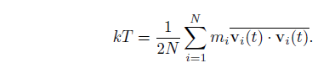
We have already introduced the definition of the kinetic temperature.
The temperature that we measure in a laboratory experiment is the mean temperature, which corresponds to the time average of T(t) over many configurations of the particles.
For two dimensions (d = 2), we write the mean temperature T as

Slide 102
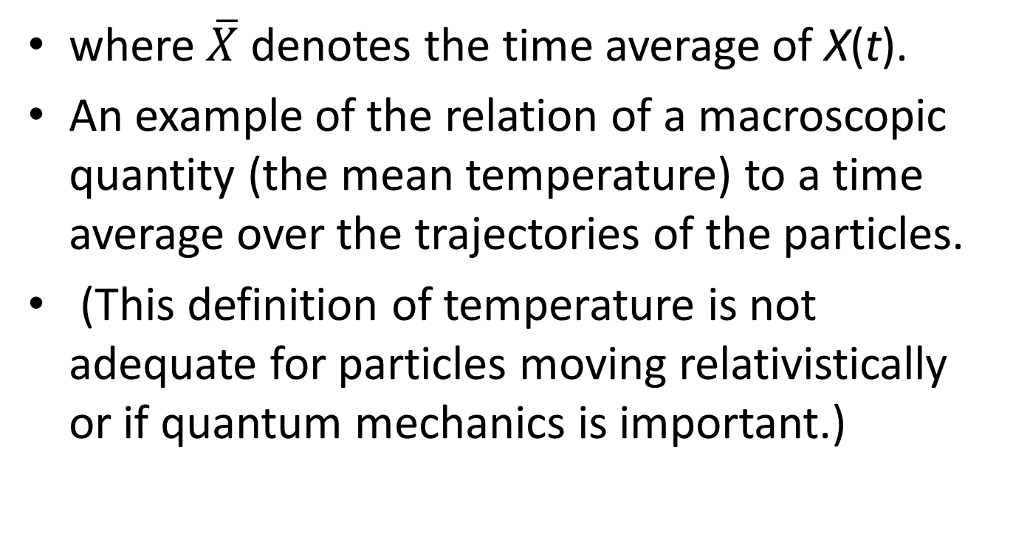
where $\overline{X}$ denotes the time average of X(t).
An example of the relation of a macroscopic quantity (the mean temperature) to a time average over the trajectories of the particles.
(This definition of temperature is not adequate for particles moving relativistically or if quantum mechanics is important.)

Slide 103
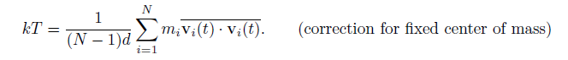
The relation holds only if the momentum of the center of mass of the system is zero!
we do not want the motion of the center of mass to change the temperature.
In a laboratory system the walls of the container ensure that the center of mass motion is zero
(if the mean momentum of the walls is zero).
In our simulation, we impose the constraint that the center of mass momentum (in each of the d directions) be zero.
Consequently, the system has dN − d independent velocity components rather than dN components, and we should replace the equation by

Slide 104
The presence of the factor (N −1)d rather than Nd is an example of a finite size correction that becomes unimportant for large N.
Another macroscopic quantity of interest is the mean pressure.
The pressure is related to the force per unit area normal to an imaginary surface in the system.
By Newton’s second law, this force is related to the momentum that crosses the surface per unit time.

Slide 105
We could use this relation to determine the pressure, but this relation uses information only from the fraction of particles that are crossing an arbitrary surface at a given time.
Instead, we will use the relation of the pressure to the virial , which involves all the particles in the system.

Slide 106
In general, the momentum flux across a surface has two contributions.
The contribution, NkT/V , where V is the volume (area) of the system, is due to the motion of the particles and is derived in many texts using simple kinetic theory arguments.

Slide 107
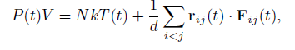
The other contribution to the momentum flux arises from the momentum transferred across the surface due to the forces between particles on different sides of the surface.
It can be shown that the instantaneous pressure at time t including both contributions to the momentum flux is given by

Slide 108
where r_{ij} = r_{i} − r_{j} and F_{ij} is the force on particle i due to particle j.
The second term is related to the virial and represents the correction to the ideal gas equation of state due to the interactions between the particles.
  (In two and one dimensions, we replace V by the area and length, respectively.)

Slide 109
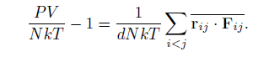
The mean pressure, P = P(t), is found by computing the time average of the right-hand side of the above equation.
The computed quantity is not P, but the ratio

